Slide 1
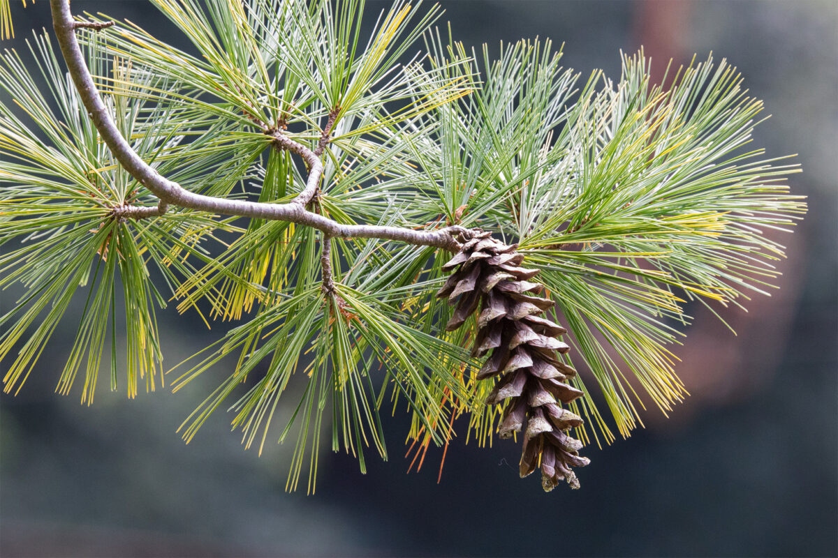
Pine Lake Township
Annual Meeting
March 10, 2026
This Photo by Unknown Author is licensed under CC BY-ND

Slide 2
Introductions
Bob Sieling – Supervisor (Chairman)
Al Starzl -- Supervisor
Pete Snortum -- Supervisor
Ken Guck – Treasurer
Susan Schmid -- Clerk
Curt Osterfeld – Maintenance, snow, grading west side of township
Tom Manning – Snow and grading east side of township
Kurt Schroeer – Maintenance east side of township

Slide 3
Other information
Website/Newsletter
We did not send a newsletter this year. It can be found on our website. https://www.pinelaketownshipotcmn.gov
Email – PLT0TC@arvig.net
Midterm elections will be at the town hall in November
Medical/Family Leave requirement
Resolutions
2024 Cannibus – turned regulation over to the county
2024 Open Book – eliminated Equalization meeting
2025 Wavy and MN Street ROW clarification
    Trail from Big Pine road to Big Pine Lake
    EMS resolutions

Slide 4
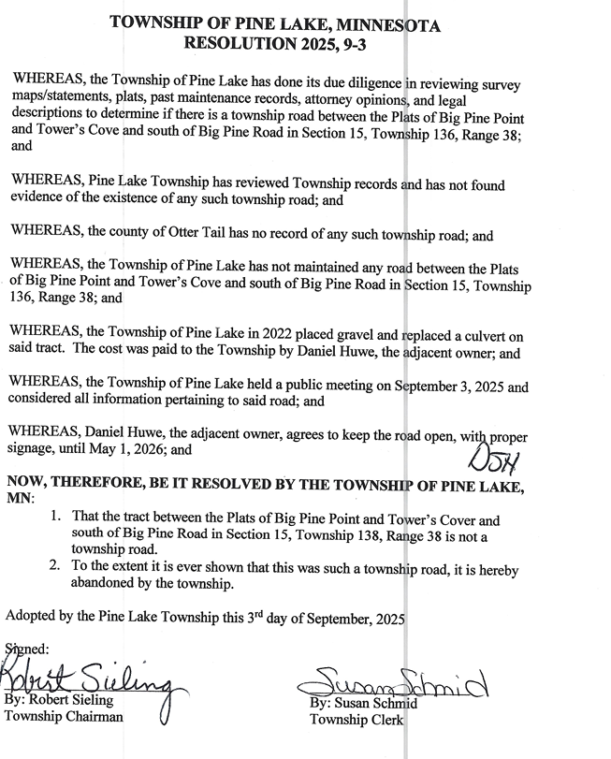
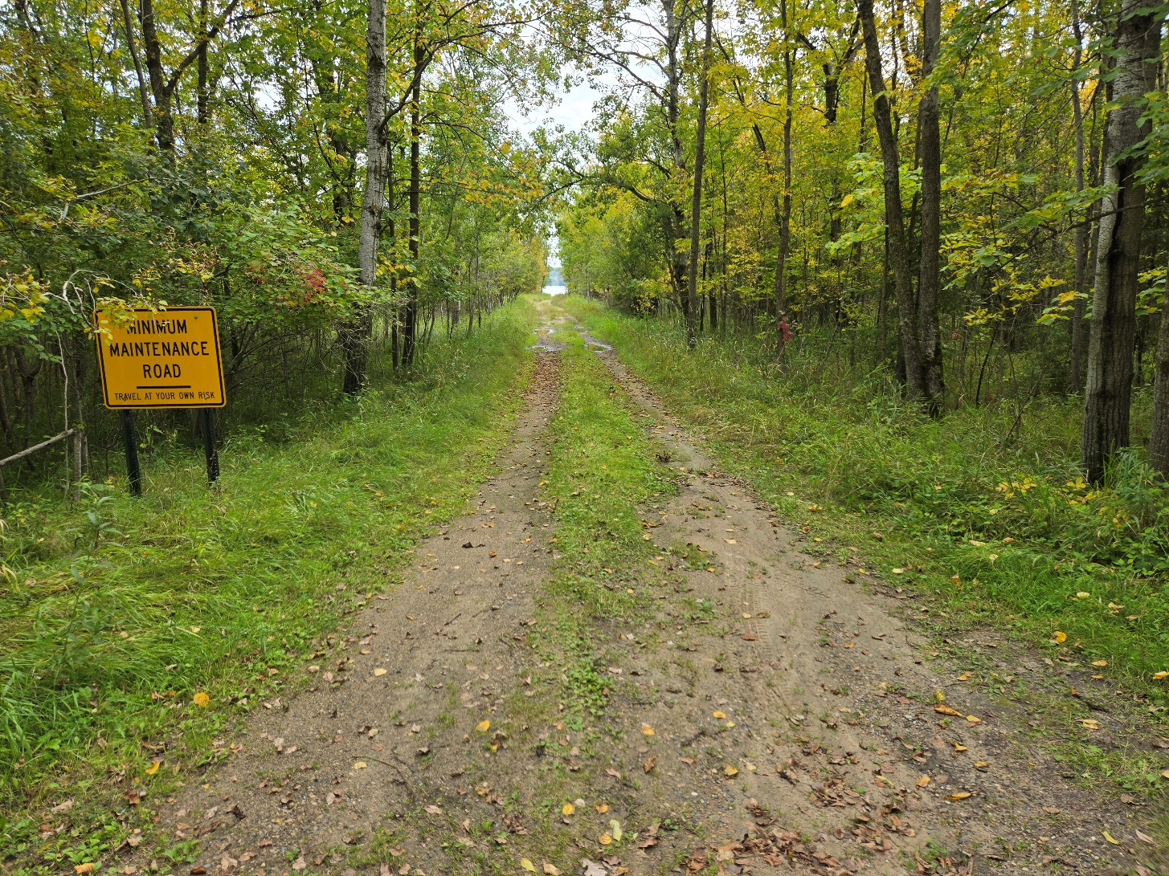

Slide 5
Emergency Medical Service
JOINT POWERS: Otto, Star Lake, Dead Lake townships have opted out (with outstanding balances). They remain in the serving district. Pine Lake has passed a resolution to keep operations going with 12 townships. An amendment to change voting process is being considered.
82.6% of calls required an ALS response
4.3 minutes – average time between notification and enroute
19 calls to Pine Lake Township (1.9% of total calls)
Sprint Mobile Grant – State funded
2024 = $34,432
2025 = $37,738
2026 = $26,250
2026 payable in 2027 projection = $40,467
Total Proposed Levy 2027 = $475,000
(try to keep levy consistent)
Alternative – dissolve joint powers
turn it over to the hospital

Slide 6
Fire Department Services
Perham Fire Department
  Serves 32 sections of Pine Lake Township
  Levy is split between City of Perham (50%) and Townships (50%) – based on Net Tax Capacity
  2025 = 192 TOTAL CALLS – 6 Pine Lake Township
  2024 -- $38,997
  2025 -- $39,081
  2026 -- $38,713
  New York Mills Fire Department
  Serves 4 sections of Pine Lake Township
  Levy is split between City of New York Mills (50%) and Townships (50%) -- based on Net Tax Capacity
  2026 -- $1,894

Slide 7
Fund Expense Breakdown
Road and Bridge Fund
  Rebuilding roads, Maintenance, Blading, Repairs, Stabilizer, Crack Sealing, Mowing Ditches, Brush/Tree Removal, Weed Spraying, Culverts, Snow Removal, Sand and Salt
  EMS and Fire Department Fund
  Perham ALS Ambulance, Perham and New York Mills Fire Department
  General Fund
  Insurance, Gopher/Beaver Bounty, Election costs, Officer Costs, Donations, Supplies/Equipment, Electric/Internet/website, Building/Site Improvements
  Disaster Fund
  Unforeseen major expenses

Slide 8

Annual Report
(Handouts)

Slide 9
Road Report (Handout)
PINE LAKE TOWNSHIP
Annual Road Report – Road and Bridge Fund
For the year ending December 31, 2025
Introduction
The township road system remained in generally good condition throughout the year, with routine grading, gravel application, repairs, and snow removal completed as needed. This report provides an overview of the year’s maintenance activities, budget use, and priorities moving into the next year.
Road Condition Summary
Gravel roads generally held up well. 470th and 460th continue to be high traffic roads that need constant attention. Paved sections show minor cracking and edge wear. 490th continues to show signs of breakup. 505th has recurring potholes.
Maintenance Completed
Gravel was added to 450th. Spot patching the paved roads was completed to maintain drivability. Regular mowing (twice a year) and brush cutting were performed to maintain visibility and safety along roadways. Chloride was added to 410, 450, 460, 470. Spot mowing was done in the fall to eradicate Spotted Knapweed, an invasive species. The township cost-shared brush removal in the right-of-way along a portion of the snowmobile trail with Perham snowmobile club. Landscaped (moved dirt, planted grass on south side of town hall, placed rocks and plants around hall)
Road Expenditures
Total road expenditures $185,233 (2025) $255,000 (5-year average)
Repairs/Maintenance $65,347 $87,961
Grading $37,229 $52,005
Snow removal $47,945 $45,511 ($23,534 - $67,420)
Road Stabilizer $17,917 $13,004
Other $16,795 (Brush/tree removal, mowing, signs, weeds, paving, crack sealing, culverts, etc)
Contractors Road maintenance was completed by contracted providers, including grading, gravel work, snow removal, and minor repairs. Road Maintenance Service serviced the east side of the township and North Central serviced the west side of the township. Contractors met our expectations and responded promptly to weather-related needs. Moving forward, Road Maintenance sold the grading and snow removal to Tom Manning. Larger projects will be handled as per Statute.
Recommendations for the coming year Looking ahead, the township plans to continue routine maintenance, address identified concerns and evaluate long-term needs. A comprehensive road trip in May will determine what projects need to be completed.
Submitted by
Bob Sieling, chairman

Slide 10
Revenue summary

Slide 11
Expense by Fund
5-year average = $33,800
5-year average = $52,191
5-year average = $255,000

Slide 12
2026 Levy proposal payable in 2027
2024 245,000 Road & Bridge – 40,000 Fire/EMS – 30,000 General = 315,000
2025: 245,000 Road & Bridge – 60,000 Fire/EMS – 10,000 General = 315,000
2026: 245,000 Road & Bridge – 75,000 Fire/EMS – 10,000 General = 330,000
2027: 235,000 Road & Bridge – 75,000 Fire/EMS – 20,000 General = 330,000
Rationale: Adequate fund balance – investment interest applied to general fund

Slide 13
2026
Possible repairs – 490th (breaking up), 505th (breaking up), 445th (dip)
Chloride – most traveled roads – every other year.
Crack sealing – three-year rotation
Gravel/patchng – where needed
Future issues – Chip seal/overlay MN Street, Mosquito Heights
Road Inspection – Supervisors will do a road inspection later this spring. We will continue to monitor with the help of our contractors. If you have any concerns, please let us know.

Slide 14

Questions or Comments
  Slides will be posted on the website
This Photo byUnknown Author is licensed under CC BY-NC

